Slide 1
2월20일 1교시 과제

Slide 2
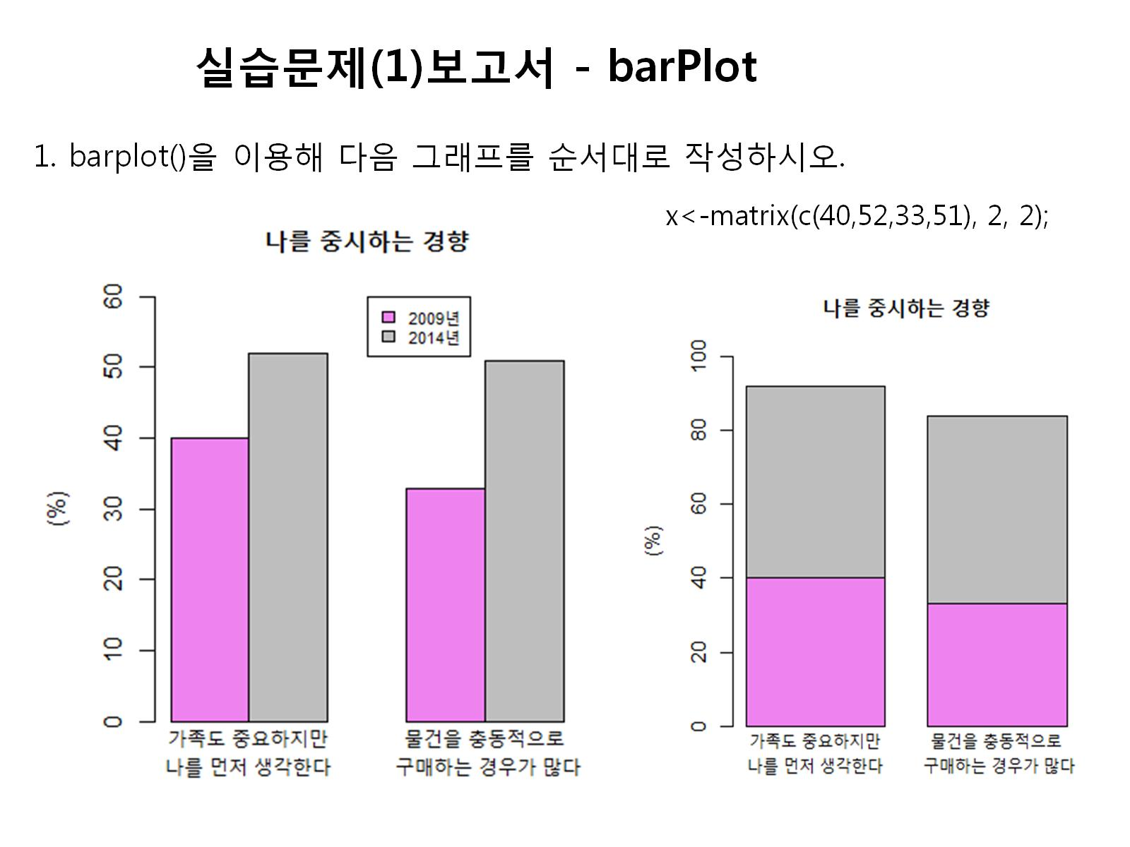

Slide 3
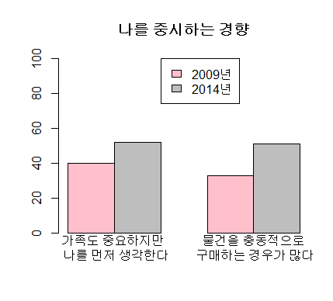
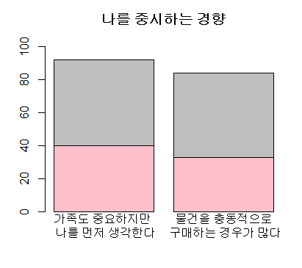
x<-matrix(c(40,52,33,51),2,2)
barplot(x,beside=T, main="나를 중시하는 경향",names=c("가족도 중요하지만 \n 나를 먼저 생각한다","물건을 충동적으로\n 구매하는 경우가 많다"),col=c("pink","gray"),ylim=c(0,100))
legend(3,100,c("2009년","2014년"),cex=1,fill=c("pink","gray"))
x<-matrix(c(40,52,33,51),2,2)
barplot(x, main="나를 중시하는 경향",names=c("가족도 중요하지만 \n 나를 먼저 생각한다","물건을 충동적으로\n 구매하는 경우가 많다"),col=c("pink","gray"),ylim=c(0,100))

Slide 4
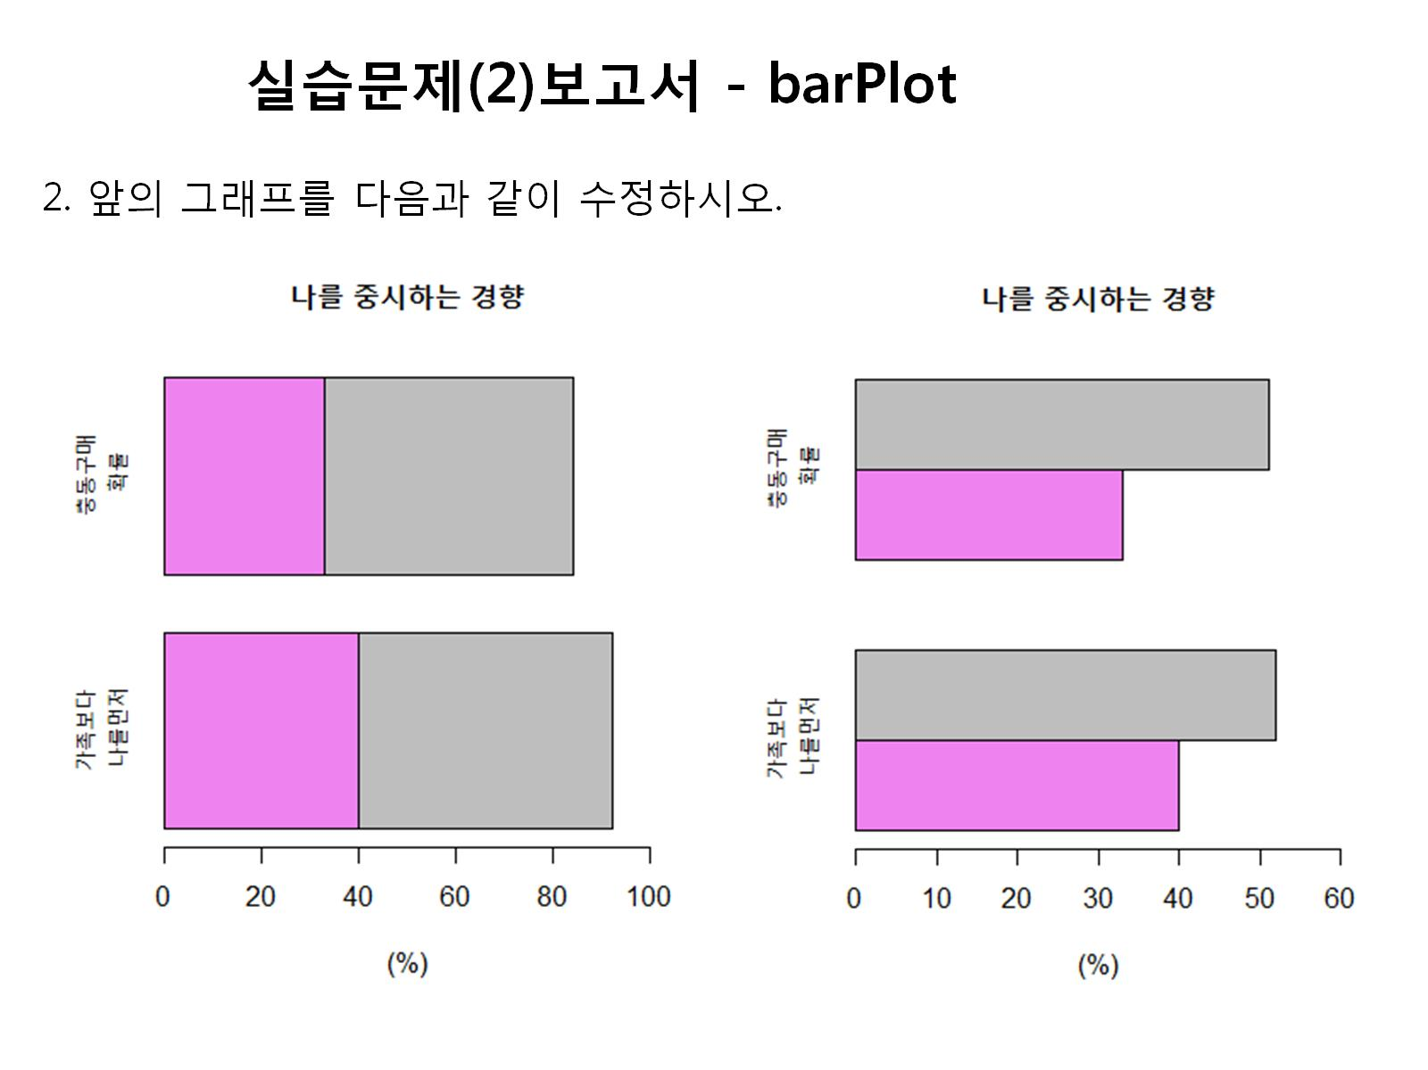

Slide 5
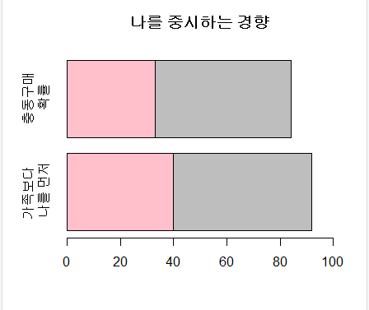
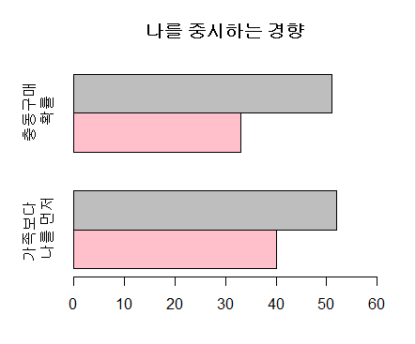
x<-matrix(c(40,52,33,51),2,2)
barplot(x, horiz=T, main="나를 중시하는 경향",names=c("가족보다 \n 나를 먼저","충동구매\n 확률"),col=c("pink","gray"),xlim=c(0,100))
x<-matrix(c(40,52,33,51),2,2)
barplot(x, beside=T, main="나를 중시하는 경향",names=c("가족보다 \n 나를 먼저","충동구매\n 확률"),col=c("pink","gray"),xlim=c(0,60),horiz=T)

Slide 6
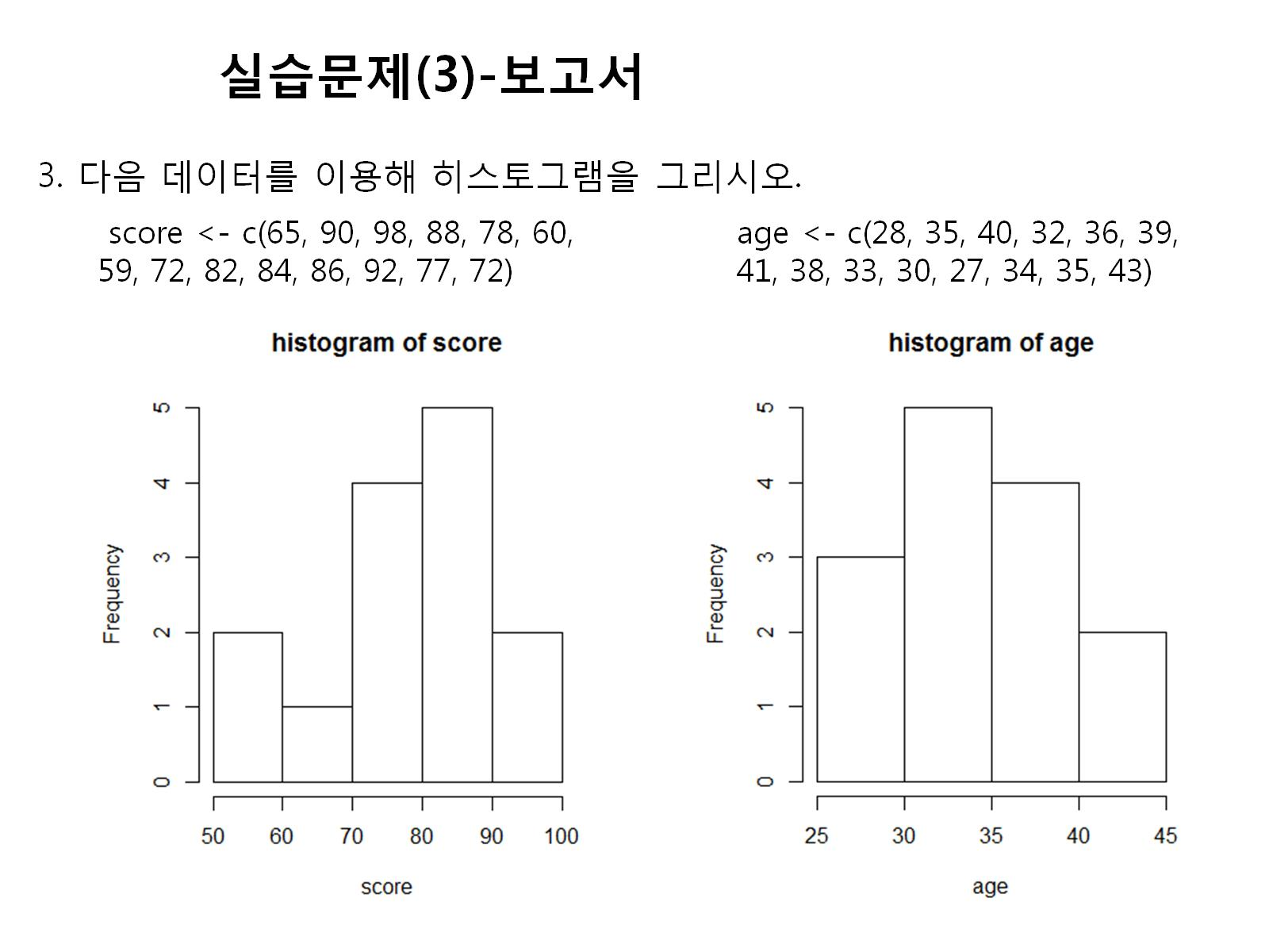

Slide 7
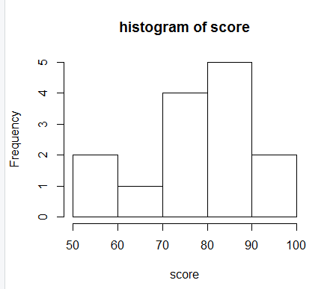
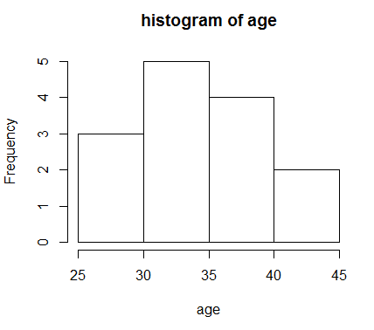
score<-c(65,90,98,88,78,60,59,72,82,84,86,92,77,72)
hist(score,main="histogram of score")
age<-c(28,35,40,32,36,39,41,38,33,30,27,34,35,43)
hist(age,main="histogram of age")

Slide 8
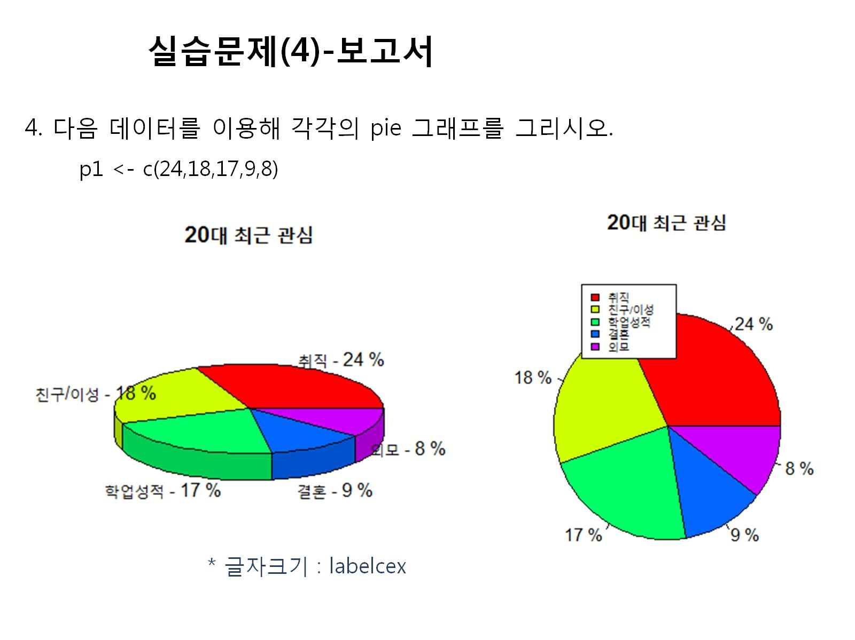

Slide 9
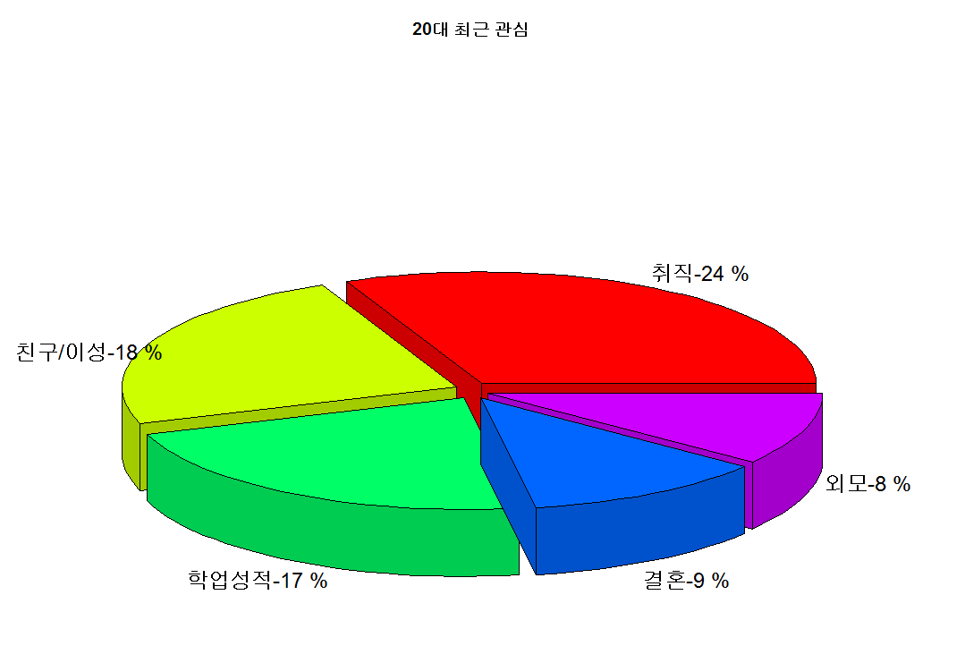
p1<-c(24,18,17,9,8)
f_day<-c("취직-24","친구/이성-18","학업성적-17","결혼-9","외모-8")
f_label<-paste(f_day,"%")
pie3D(p1,main="20대 최근 관심", col=rainbow(length(p1)),cex=0.5,labels=f_label,explode=0.05)

Slide 10
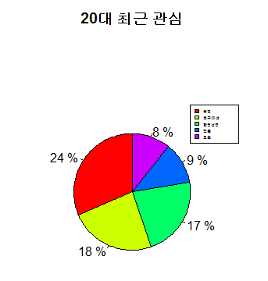
p1<-c(24,18,17,9,8)
f_day<-c("24","18","17","9","8")
f_label<-paste(f_day,"%")
pie(p1,main="20대 최근 관심",radius=1,init.angle = 90,col=rainbow(length(p1)),label=f_label)
legend(1,1.5,c("취직","친구/이성","학업성적","결혼","외모"),cex=0.3,fill=rainbow(length(p1)))

Slide 11
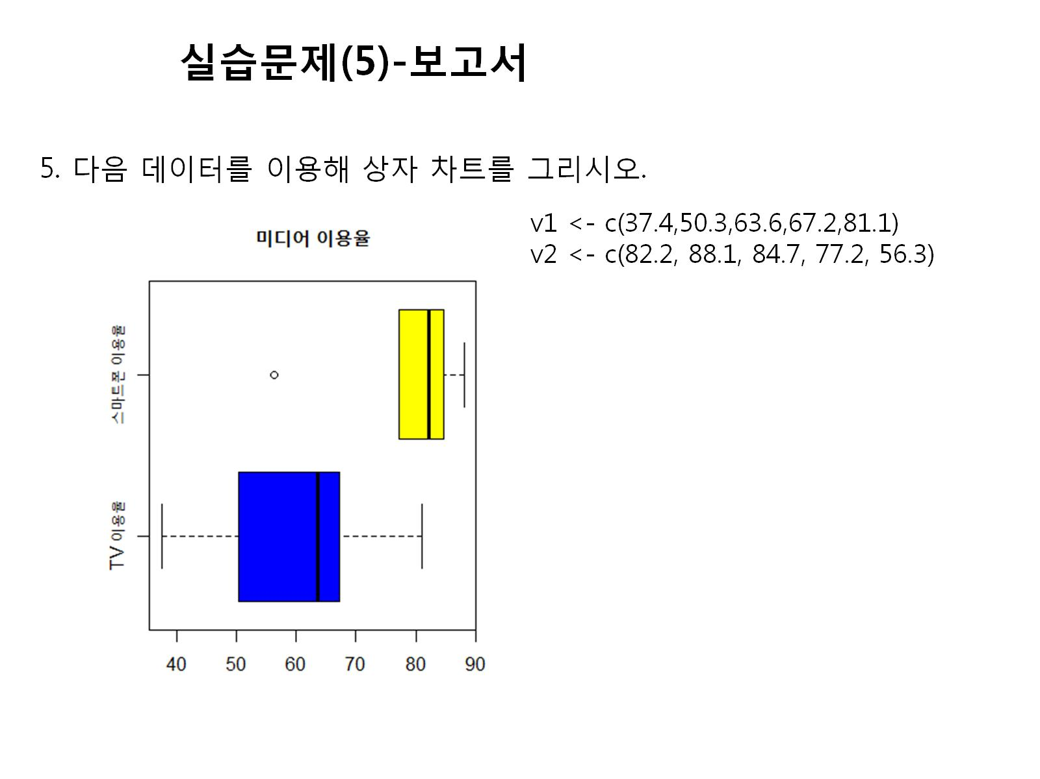

Slide 12
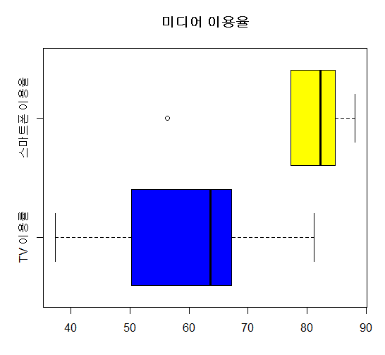
v1<-c(37.4,50.3,63.6,67.2,81.1)
v2<-c(82.2,88.1,84.7,77.2,56.3)
boxplot(v1,v2,main="미디어 이용율",col=c("blue","yellow"),names=c("TV 이용률","스마트폰 이용율"),horizontal = T)

